Slide 1
Lecture 38 – CST370 Wrap Up
CST370 – Design & Analysis of Algorithms
Dr. Byun
Computer Science

Slide 2
Lecture Objectives
After completion of this lecture, you will be able to
  remind main topics covered in CST370 and wrap up the class.

Slide 3
Main Objectives of CST370
Learn algorithm design techniques
  Brute force
  Divide-and-conquer
  Greedy method
  etc.
Learn important data structures
  Hash, heap, tree, graph, etc.
Analyze efficiency of algorithms
  Three notations

Slide 4
Algorithm Design Techniques (1 of 3)
Brute-force
  Sequential search
  Exhaustive search
Divide-and-conquer
  Mergesort
  Quicksort
Decrease-and-conquer
  Insertion sort
  Binary search

Slide 5
Algorithm Design Techniques (2 of 3)
Transform-and-conquer
  Presorting
  Balanced search tree
  Heaps
  Problem reduction
Space and time tradeoffs
  Hashing

Slide 6
Algorithm Design Techniques (3 of 3)
Dynamic programming
  Coin-row problem
  Warshall’s algorithm
  Floyd’s algorithm
Greedy method
  Prim’s algorithm
  Kruskal’s algorithm
  Dijkstra’s algorithm

Slide 7
Important Data Structures (1 of 2)
Stack & Queue
Tree
  Binary tree
  Balanced search tree
Graph
  Undirected Graph
  Directed Graph
  DFS and BFS

Slide 8
Important Data Structures (2 of 2)
Hash
  Hash function and hash table
  Separate chaining
  Linear probing
Heap
  Max heap and min heap
  Priority queue
Trie
  ???

Slide 9
Trie
A tree-like data structure which provides fast retrieval of strings for searching words, auto suggestions in a search engine, etc.
Reference
  Author: Robert Sedgewick and Kevin Wayne
  Title: Algorithms (4th edition, 2011)
  Publisher: Addison-Wesley Professional
  https://algs4.cs.princeton.edu/lectures/keynote/52Tries.pdf

Slide 10
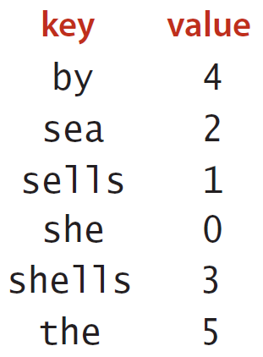
Trie – Example (1 of 2)
Assume that you have many strings and their values like below.
  How would you provide very efficiently search?

Slide 11
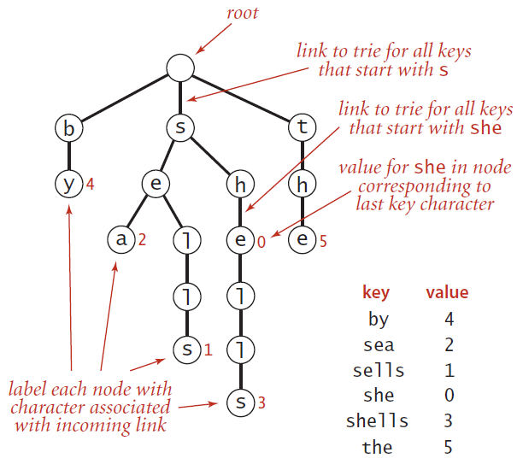
Trie – Example (2 of 2)

Slide 12
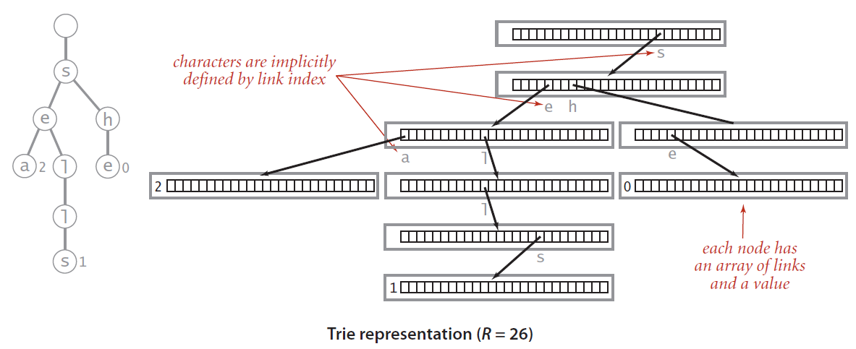
Trie Representation – Example

Slide 13
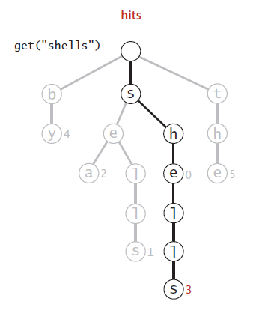
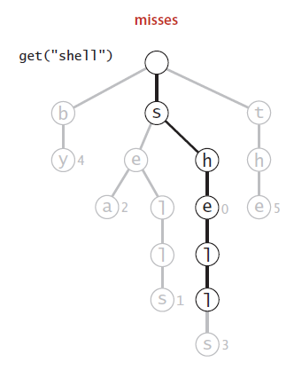
Trie – Example (Search)

Slide 14
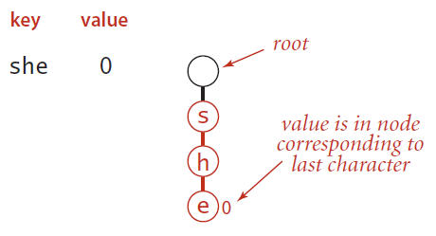
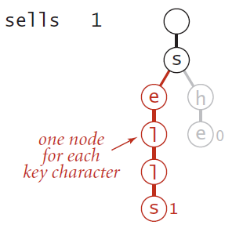
Trie – Example (Insertion (1 of 2))

Slide 15
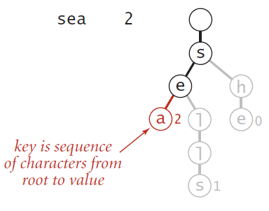
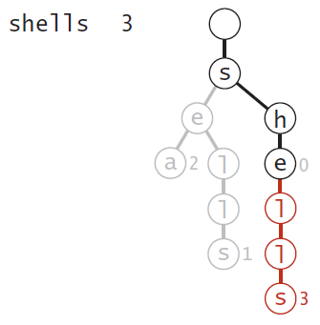
Trie – Example (Insertion (2 of 2))

Slide 16
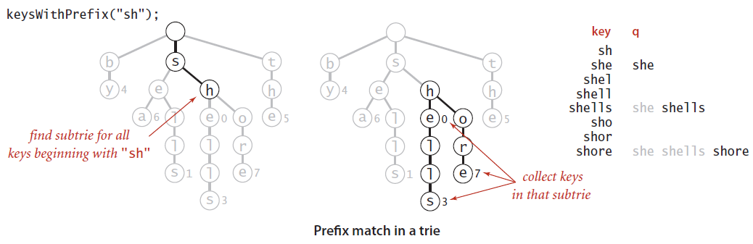
Trie – Example (Prefix Matching)

